Slide 1


MITRON BANK
M
Presented by
Sivabavithraa

Slide 2
Table of contents
Problem Statement
Dataset
Customer Demography
Income Utilization % of customer
Spending patterns
Key Insights
Recommendations

Slide 3
Problem Statement
Mitron Bank is a legacy financial institution headquartered in Hyderabad. They want to introduce a new line of credit cards, aiming to broaden its product offerings and reach in the financial market.
As a data analyst my job is to analyze the data and report the key findings to the strategy team and strategy director Mr.Bashnir Rover of Mitron Bank to customize credit card as per the customer needs and market trends

Slide 4


Dataset
Dim Customer
Gender
Age
Marital status
Occupation
City
Average Income
Fact spend
Category
Month
Amount Spend

Slide 5
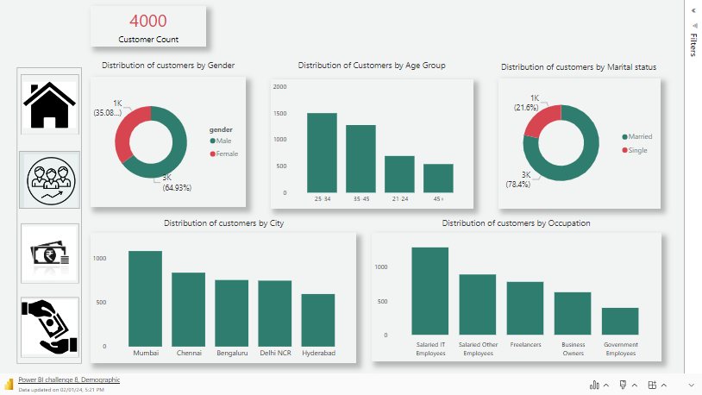
DEMOGRAPHY

Slide 6
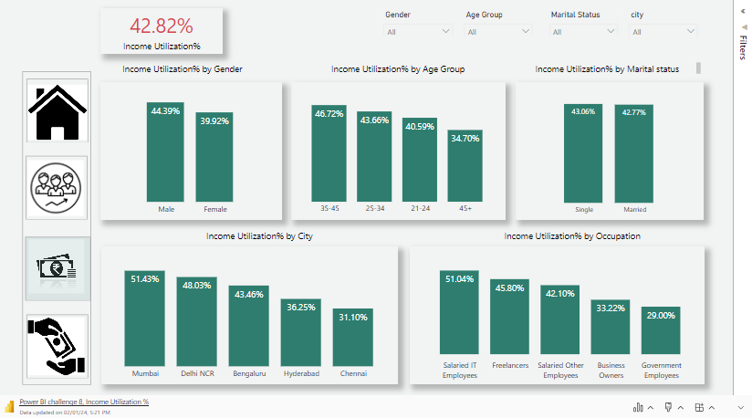
INCOME UTILIZATION%

Slide 7
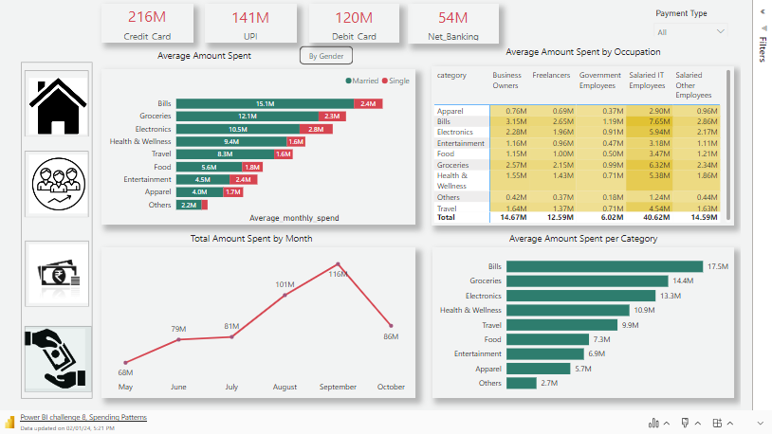
SPENDING PATTERNS

Slide 8
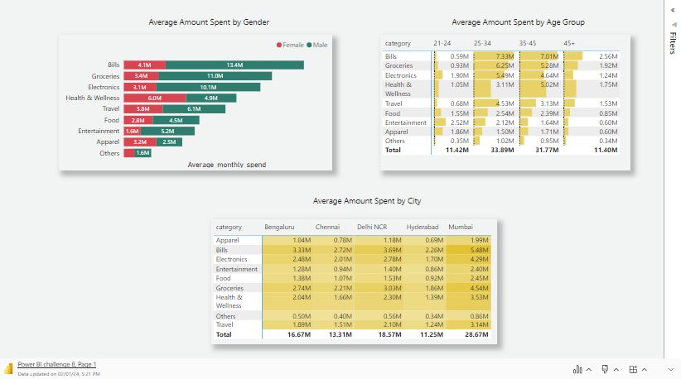

Slide 9
Key Findings
Income Utilization - 42.85 %
Customers from Mumbai, Delhi, Bengaluru have income utilization % of 51.43, 48.03,43.46 respectively
Salaried IT Employees followed by Freelancers and Salaried other Employees have income Utilization % of 51.04,45.80,42.10 respectively
Age group 35-45,25-34,21-24 have income utilization % of 46.72,43.66,40.59 respectively

Slide 10
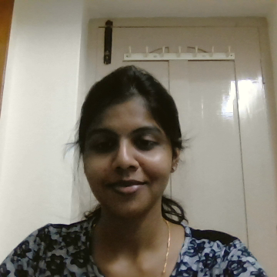
On an average customers mostly spend their money in Bills, Groceries, Electronics and Health and wellness
Salaried IT Employees, Freelancers, Other salaried employee spend their income in Bills, Groceries, Electronics and Health and wellness
Age group
35-45-Bills, Groceries, Health and wellness, Electronics
25-34- Bills, Groceries, Electronics , Travel
21-24- Entertainment , Electronics, Apparel, Food
Total amount spent peaked during the month of September due to Diwali
People prefer UPI next to Credit Card for payment

Slide 11
Recommendations
Card 1( Primary focus: Bills)
Cashback offers , reward points on payment of bills
Reward points on online medical purchases
Free Annual health check up
Lounge access in airports
Cashback offers on bus ticket and train tickets
Card 2 (Primary Focus: Groceries)
Cashback offers and reward points on grocery purchases
Colloborating with E-commerce platforms to provide exclusive offers on grocery purchase
Cashback offers on Electronic purchase
Colloborating with specific electronic brands to provide exclusive offers
No cost EMIs on Electronic purchase

Slide 12
Card 3 ( Primary Focus: Entertainment)
Cashback on movie tickets
Cashback on food and beverages at theatres
Offers on food through delivery apps
Reward points on amount spent in food
Cashback in Electronic purchases
Cashback offers in clothing purchases
General Recommendations
Exclusive offers during festivals
Customize virtual RuPay credit cards to enable users to use them on UPI
Point of contact for all credit card customers to listen to their queries
Protection against fraud, cyber threats and international shopping
Membership plans for customers

Slide 13



Thankyou

